Slide 1
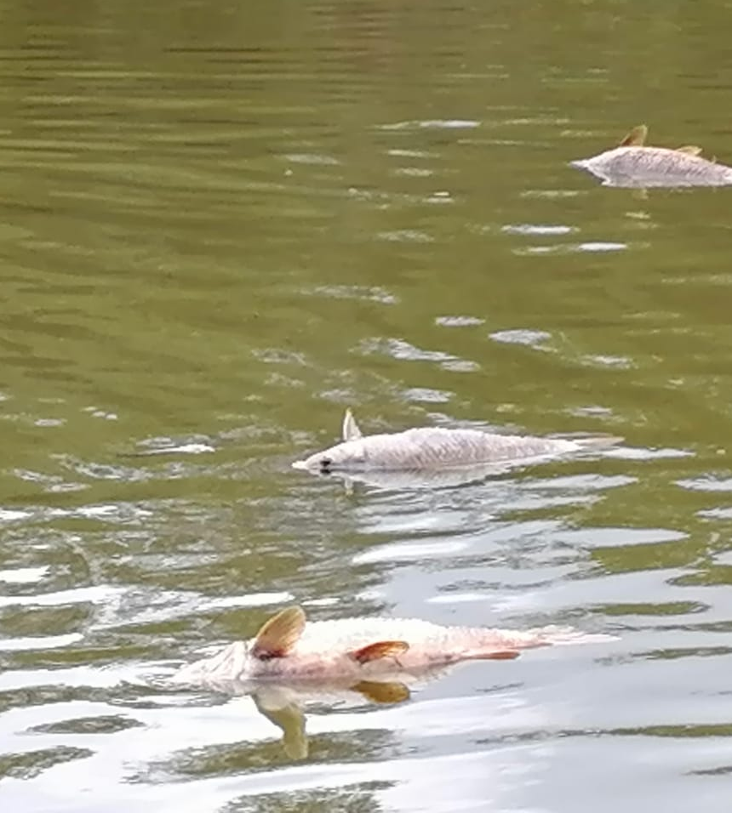
THE PROBLEM
25 million litres a day.
Ten Olympic swimming pools. Every day.
That is how fast water collects in the old coal mines beneath eMalahleni. Much of it will one day leave those mines without anyone testing it.
The Sindane family
They have farmed in Mpumalanga for more than 60 years. Now surrounded by a coal mine, they told Parliament that the water their livestock drink is being poisoned by mine waste water. About 500 families in the province face the same.
zMz | Kusile WaterGuard
Sources: Parliament of South Africa (2022); [eMalahleni study]
1
Notes:
Say the hook slowly. "Every single day, 25 million litres of water collects in the old coal mines beneath eMalahleni. That's ten Olympic swimming pools. Every day. And much of it will one day leave those mines without anyone testing it." Pause for two seconds. Then: "For more than 60 years, the Sindane family has lived on their farm in Mpumalanga. Today they are surrounded by a coal mine, and they told Parliament that the water their livestock drink is being poisoned by the mine's waste water. They are one of about 500 families in the province facing a similar situation." Present this as their reported experience, not a proven finding, and do not name the neighbouring mine.

Slide 2
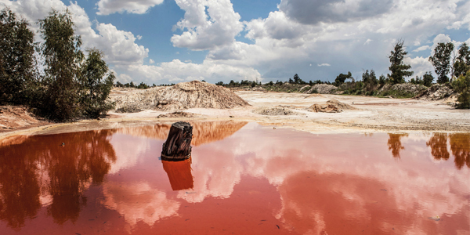
How mine water reaches our rivers
Mines must store dirty water in dams. But a dam only stores water. It does not clean it.
LICENSED RELEASE
UNCONTROLLED RELEASE
WHEN IT GETS OUT
Seriti Resources, Arnot Colliery
Woestalleen Colliery, near Hendrina
Thungela Resources, Kromdraai mine
Building a plant to treat mine water and release it into the Bosmanspruit under its water use licence.
DWS (Department of Water and Sanitation) opened a criminal case after suspending its licence for continued pollution.
February 2022: water exceeded treatment capacity and killed 58 km of the Wilge River system within days.
112 km
Carolina, 2012
Acidic mine water reached the town's supply dam. 17,000 residents lived on water tankers for nine months.
of river with no fish two years later. Clean up bill: about R1 billion.
zMz | Kusile WaterGuard
Sources: DWS (2020); Mail & Guardian (2022); Daily Maverick (2024); Human Rights Watch (2022)
2
Notes:
"Every coal mine must get rid of water. Mines are required by law to collect dirty water in pollution control dams. But a dam only stores water; it doesn't clean it. Eventually the water leaves, in one of two ways. Some mines are licensed to release treated water into rivers: Seriti Resources' Arnot Colliery is building a plant to treat mine water and discharge it into the Bosmanspruit under its water use licence. Others release it without control. The Department of Water and Sanitation opened a criminal case against Woestalleen Colliery near Hendrina after suspending its water use licence for continued pollution. When dirty water gets out, the damage spreads fast. In February 2022, acid water from the old Kromdraai mine near eMalahleni, owned by Thungela Resources, killed a 58 km stretch of the Wilge River system within days. The company said the volume exceeded the maximum capacity at its treatment point. Two years later, 112 km of river still had no fish, and the bill reached about R1 billion. In Carolina, acidic water from old coal mines flowed into the town's supply dam, leaving about 17,000 residents on water tankers for nine months." Say the names in a neutral tone. Stick to what the sources say.

Slide 3
What leaves the mine, untested
Measure | Sampled mine water | Target
pH | 2.69 to 3.30 | 5.5 to 9.5
Electrical conductivity | 1,863 to 3,110 µS/cm | 1,000 µS/cm
TDS (Total Dissolved Solids) | 913 to 1,524 mg/L | Not listed
Iron | 20 to 56 mg/L | Above discharge guideline
Aluminium | 51 to 89 mg/L | Not listed
Manganese | 9 to 21 mg/L | Not listed
A spill takes hours. A monthly test finds it weeks later.
The regulator failed to monitor mines' water licence compliance. Some Olifants River stations were cut from weekly to monthly sampling.
PROBLEM STATEMENT
Mpumalanga's mine water reaches rivers through licensed releases, overflows, illegal decanting and abandoned mines, and nobody tests it at the moment it leaves. Mpumalanga needs an affordable, on site system that tests mine water before release and stops water that is not clean
zMz | Kusile WaterGuard
Sources: [eMalahleni study]; Centre for Environmental Rights (2019)
3
Notes:
"This is the water sitting in the pits. A pH of 3 is closer to vinegar than to drinking water, and it carries iron, aluminium and manganese with it. Whether a release is licensed or not, the problem is the same: nobody tests the water at the moment it leaves the mine. The regulator has failed to monitor mines' water licence compliance, and some river monitoring stations were cut to monthly sampling. A spill takes hours; a monthly test finds it weeks later." Pause here. Then read the problem statement: "Mpumalanga needs an affordable, on site system that tests mine water before it is released, proves that licensed releases meet their limits, and automatically holds back or treats water that is not clean, so no family downstream finds out too late." Add the full name of the eMalahleni study to the source line.

Slide 4
THE SOLUTION
What if the water had been tested before it left the mine?
What if the Sindane family knew the water their cattle drink is clean?
What if every litre leaving a coal mine had to pass a test first?
That's why we built Kusile WaterGuard.
zMz | Kusile WaterGuard
4
Notes:
Pause for about one second after each "What if" line. The first line names the problem, the second makes it personal, the third sets up the solution. Say "That's why we built AcidShield" slightly louder and more slowly. Keep this under 15 seconds, then move on with: "Right now, none of those what ifs are possible. Here's why."

Slide 5
A smart gate between the dam and the river
Kusile WaterGuard is a low cost node at the outlet of a mine's pollution control dam. It tests water in batches, releases only clean water, and holds back and treats water that fails.
The gap today | How AcidShield closes it
Testing is too late: some river stations sample only monthly | Tests every batch on site, before release
Storms overwhelm treatment, as at Kromdraai | If the treatment tank is full, the batch is held, not released
Mines' licence compliance is not monitored | Logs every release: batch, result, time and route
Plants are huge: about R300 million for eMalahleni's original 25 ML/day plant | A low cost node at every dam outlet
Licensed releases
Proves every batch meets the licence limits, with an automatic record.
Uncontrolled releases
Stops dirty water from leaving and raises the alarm when something goes wrong.
No test, no release.
zMz | Kusile WaterGuard
ML = megalitres
5
Notes:
"AcidShield sits at the outlet of the mine's pollution control dam, the last point before water leaves the site. The dam holds the water. AcidShield decides whether it's safe to let go." Walk the table row by row: each gap today, and how AcidShield closes it. If asked whether you treat the water: "Our node neutralises acidic water on site, which is the most urgent danger. For water that also needs salts removed, AcidShield doesn't release it; it holds it and routes it to full treatment." If asked about storms: "We can't stop the storm, but we can make sure the dam isn't already full when it arrives, and that nobody finds out weeks later." Do not claim AcidShield would have prevented Kromdraai; say it is designed to catch releases like it.

Slide 6
Methodology: test before release
1. Fill
2. Test
3. Decide
4. Treat
5. Release
Sump pump fills the check chamber, then stops at 100 L
Controller averages the pH and TDS readings
Pass: pH ≥ 6.5 and TDS ≤ 1,200 mg/L, V1 to river. Fail: V2 to treatment tank
Dosing pump adds neutraliser until tank pH reaches 6.8
pH safe for 3 seconds, then V3 releases treated water
Real device | Tinkercad replacement
ESP32 microcontroller | Arduino Uno
pH and TDS probes | Potentiometers
Solenoid valves V1, V2, V3 | Micro servos (0° shut, 90° open)
Sump and dosing pumps | DC motors
Flow meter | Code counts the litres
WiFi and 3D digital twin | Serial Monitor
Built in safety
Tank full: the failed batch is held in the chamber.
Neutraliser empty: dosing stops, V3 stays locked, alarm.
Lights: green pass, red fail, yellow testing or empty.
zMz | Kusile WaterGuard
TDS = Total Dissolved Solids | Same logic, simulated hardware
6
Notes:
"Mine water is caught in 100 litre batches and tested before any of it reaches the river." Walk the five steps left to right. Then: "In Tinkercad, parts that don't exist are replaced: potentiometers act as the probes, servos act as the valves, DC motors act as the pumps. The Serial Monitor stands in for the 3D twin feed; the real device sends the same data over WiFi." Run the simulation live: turn the Chamber pH knob left to trigger a failed batch, then flip the slideswitch to show the neutraliser empty alarm. Current limits if asked: no upper pH limit yet (add pH ≤ 9.5), the tank corrects pH but not TDS, and flow is counted in code instead of a real flow sensor.

Slide 7
Commercialization: who pays and how we earn
~R21 000
~R300 million
~R1 billion
One node (ranges from about 8500 to 21000)
eMalahleni's original 25 ML/day plant
Kromdraai response bill
Who pays
Operating coal mines | Prove releases meet licence limits
Owners of closed mines | Responsibility continues after closure
Water treatment operators | Add nodes at plant outlets
Municipalities, water boards | Early warning at water intakes
Kusile WaterGuard as a Service
Once off: hardware and installation
Monthly: monitoring subscription and dashboard
Ongoing: maintenance, calibration, sensors, neutraliser and compliance reports
Legal driver: GN 704 regulations require mines to keep polluted water out of rivers.
Prototype (now)
→
Controlled pilot
→
Field pilot with a mine
→
Commercial product
→
Node network across a mine
zMz | Kusile WaterGuard
A small gate at every dam outlet costs far less than one spill.
7
Notes:
"Monitoring tells you there's a problem. Treatment plants clean it later. AcidShield stops it at the gate." Point to the three numbers: one node, versus about R300 million for eMalahleni's original plant, versus about R1 billion after Kromdraai. Then the customers: operating mines need proof their releases meet licence limits, owners of closed mines stay responsible (Kromdraai closed 56 years before its spill), treatment operators can add nodes at their outlets, and municipalities get early warning at their intakes. The legal driver means customers need a solution, not just want one. Business model: a once off hardware and installation fee, a monthly monitoring subscription, and ongoing maintenance, calibration, sensor replacement, neutraliser supply and compliance reports. Close with the roadmap from prototype to a network of nodes across a mine. Fill in the node cost once parts are priced; do not guess a number.

